Slide 1
HYPOTHESIS SPACE SEARCH AND
GENETIC
PROGRAMMING

Slide 2
HYPOTHESIS SPACE SEARCH
Genetic Algorithms (GA) and Crowding:
Genetic Algorithms use a randomized beam search method to find the best solution (hypothesis) in a population.
Crowding happens when highly fit individuals dominate the population, reducing diversity.
Reducing Crowding:
Use a different fitness function instead of Roulette wheel selection.
Restrict the types of individuals that can generate offspring.

Slide 3
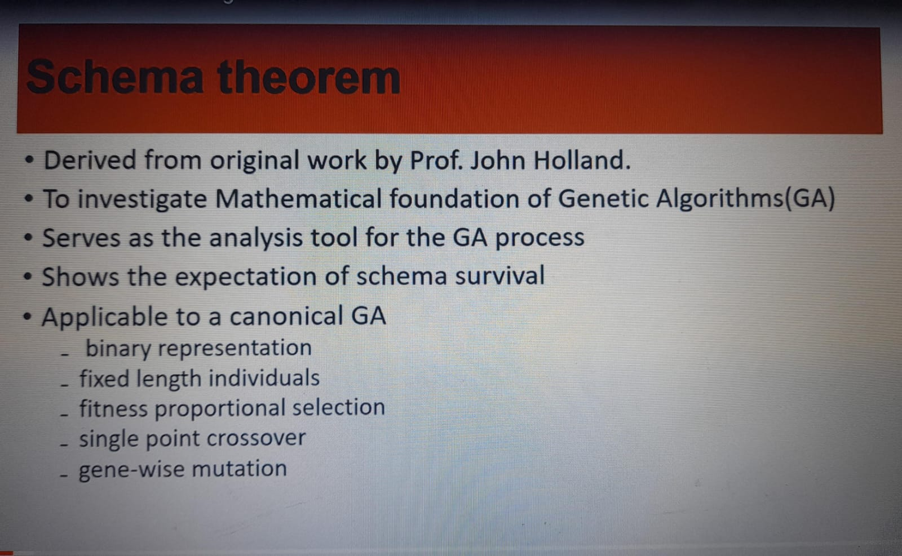
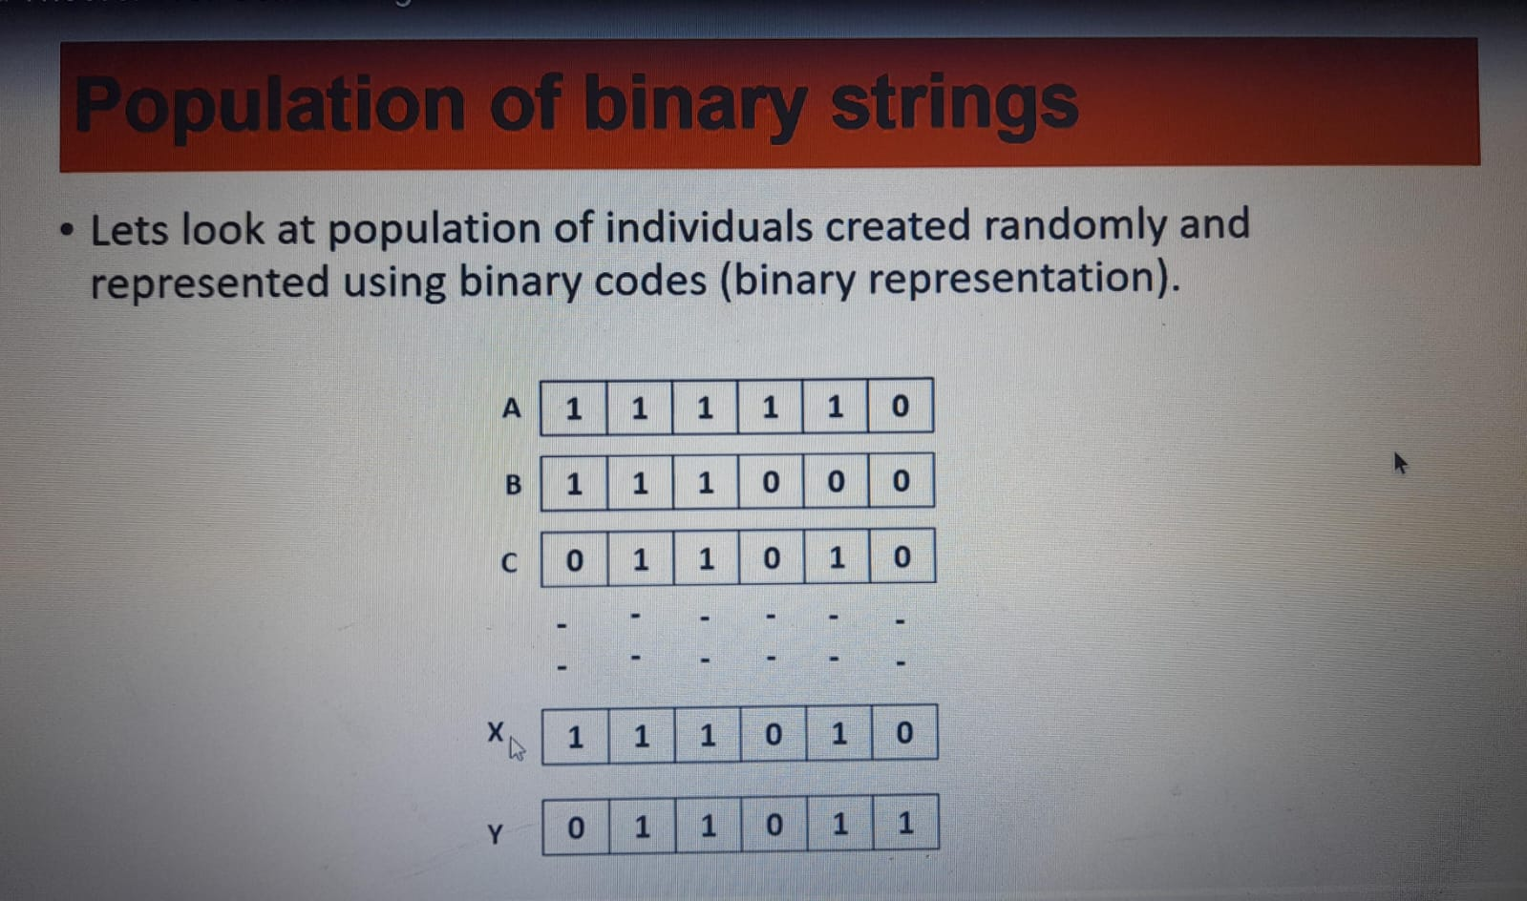
SCHEMA THEOREM
POPULATION OF BINARY STRINGS

Slide 4
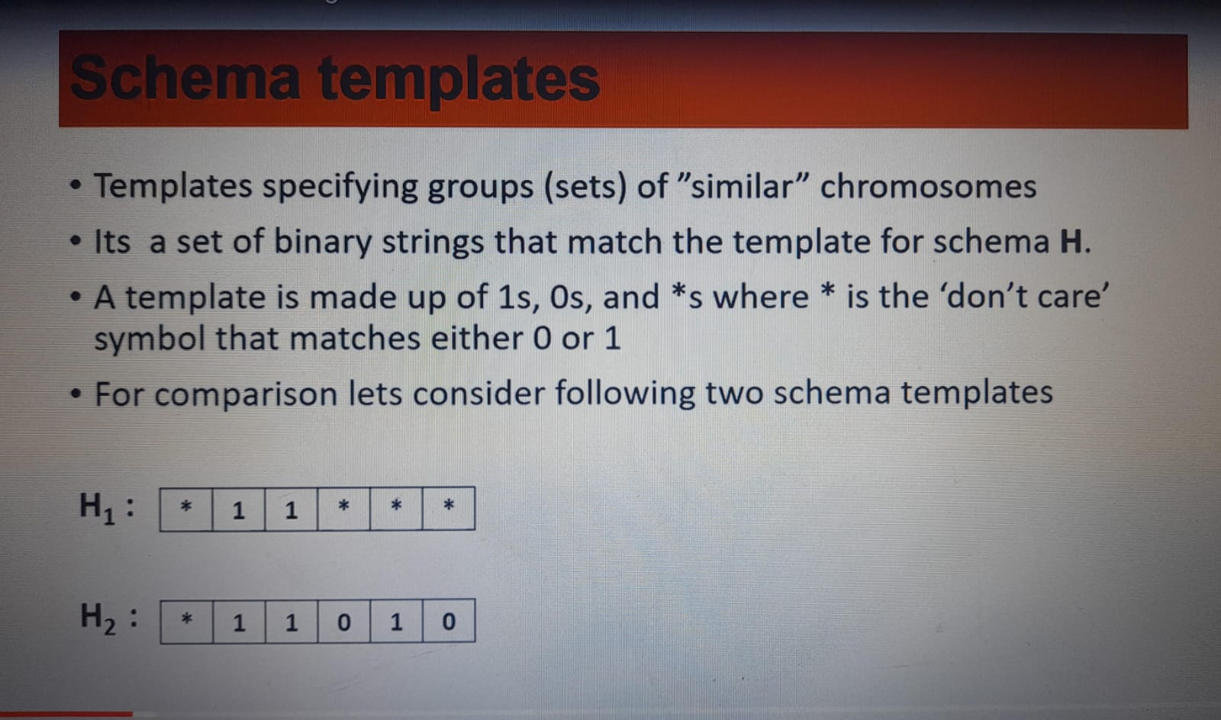
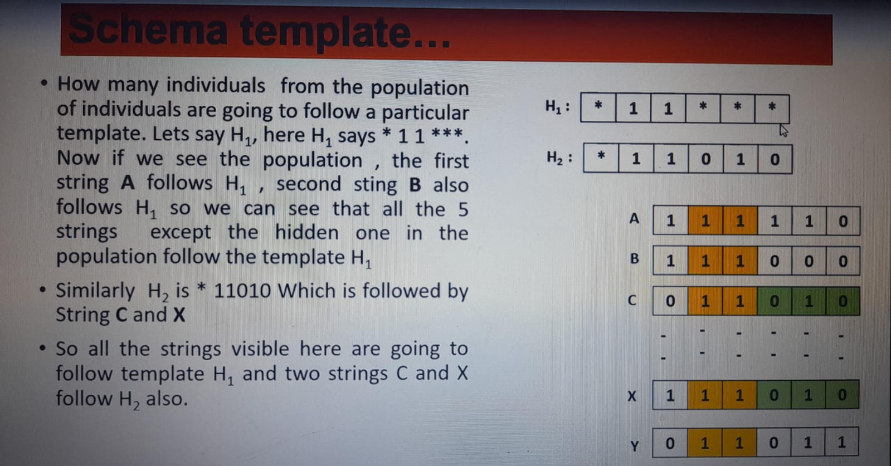
SCHEMA TEMPLATES
SCHEMA TEMPLATE...

Slide 5
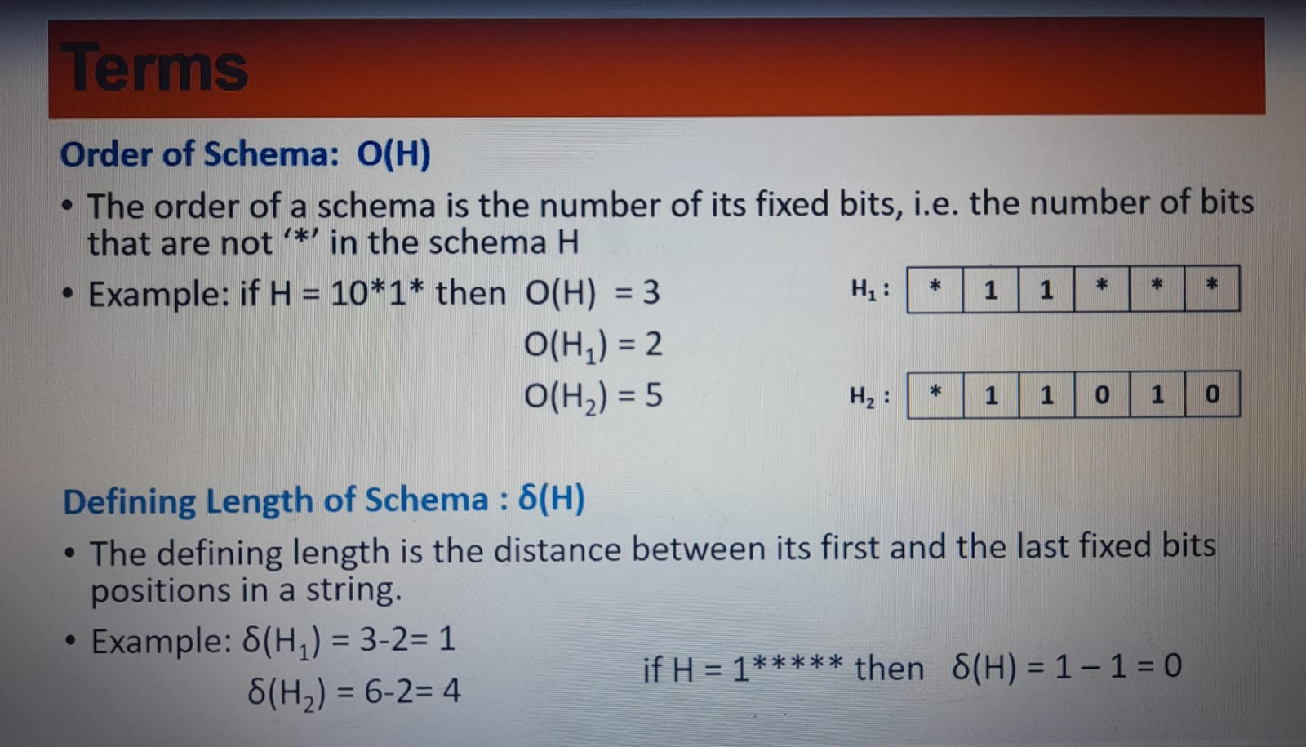
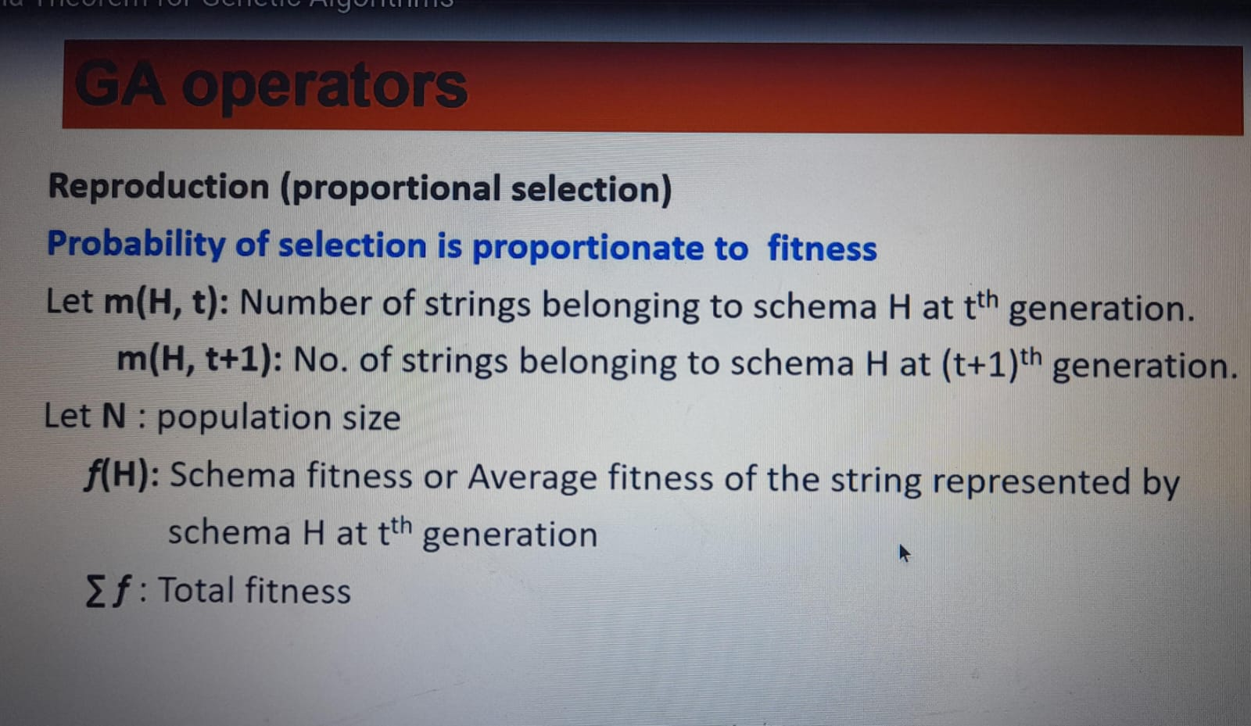
TERMS
GA OPERATORS

Slide 6
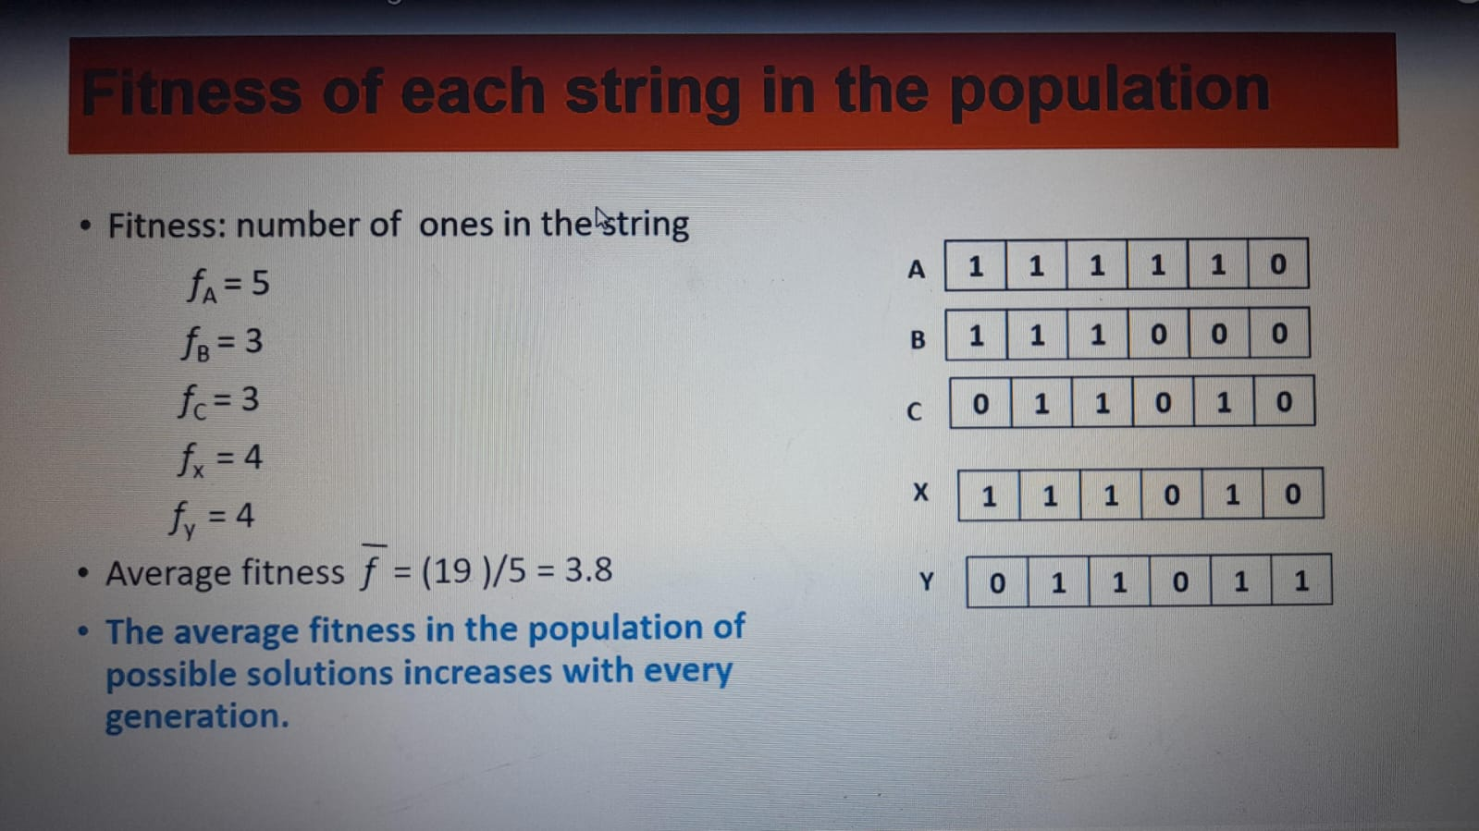
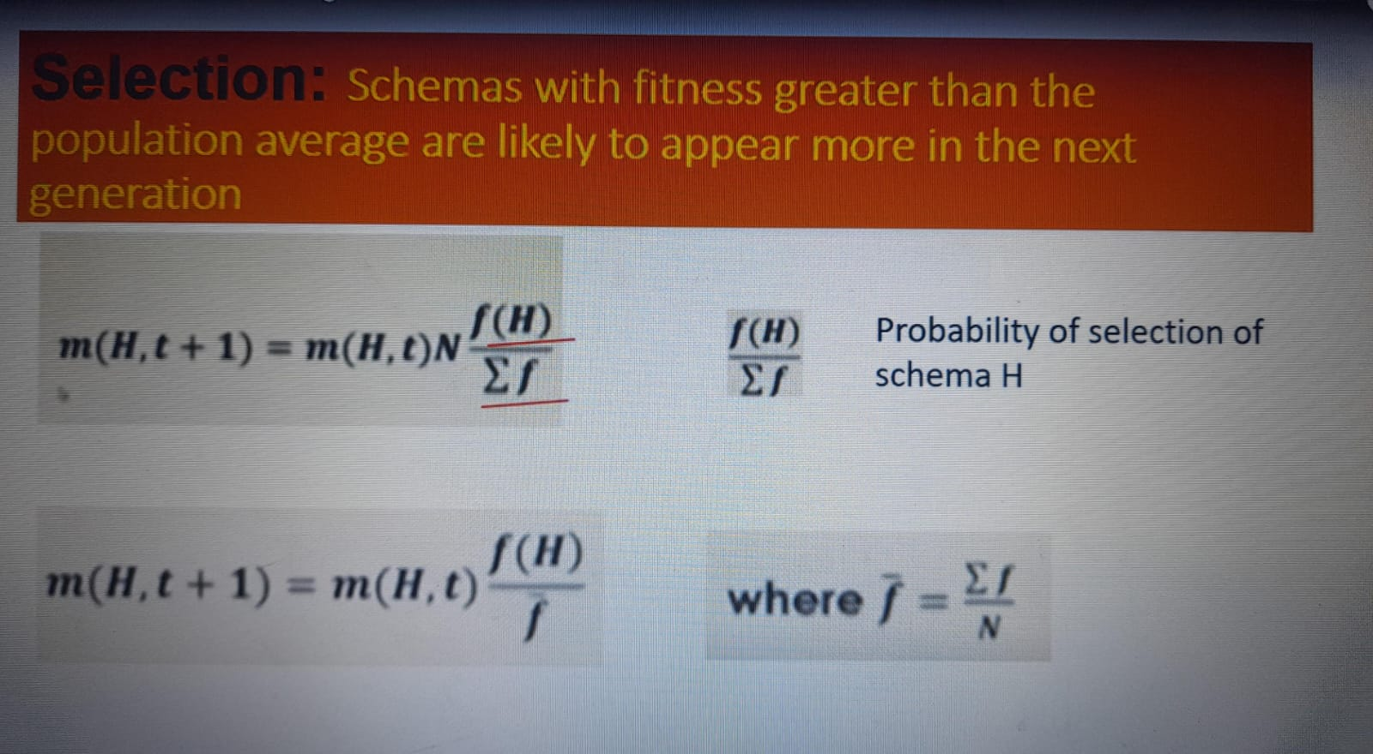
FITNESS OF EACH STRINGIN THE POPULATION

Slide 7
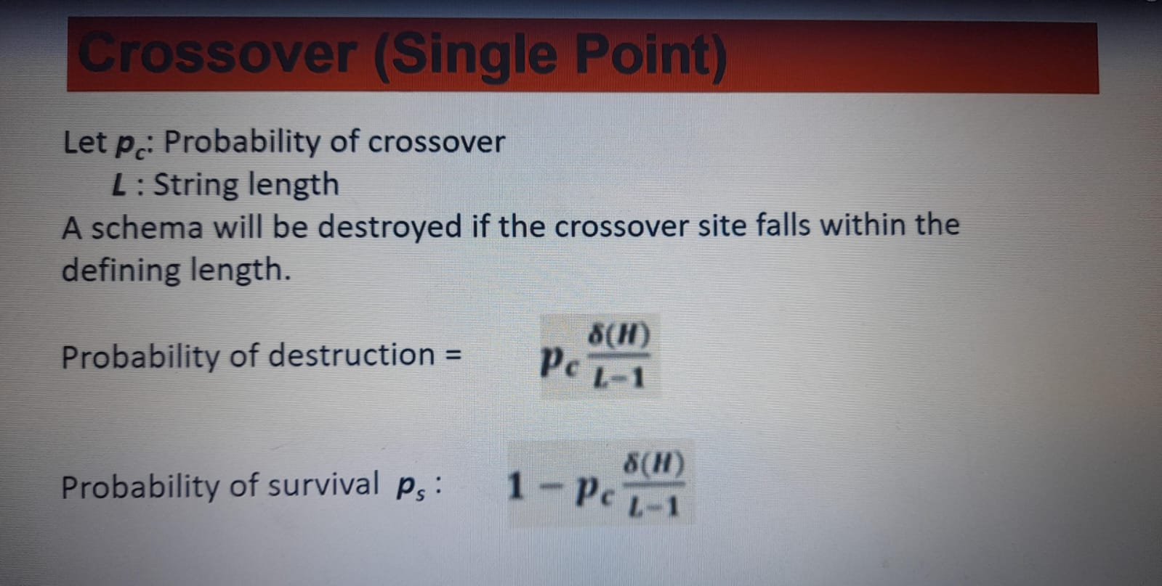
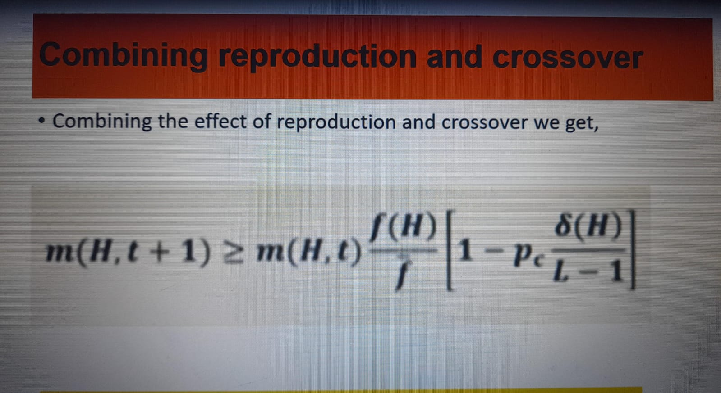
CROSSOVER (SINGLE POINT)
COMBINING SELECTION AND CROSSOVER

Slide 8
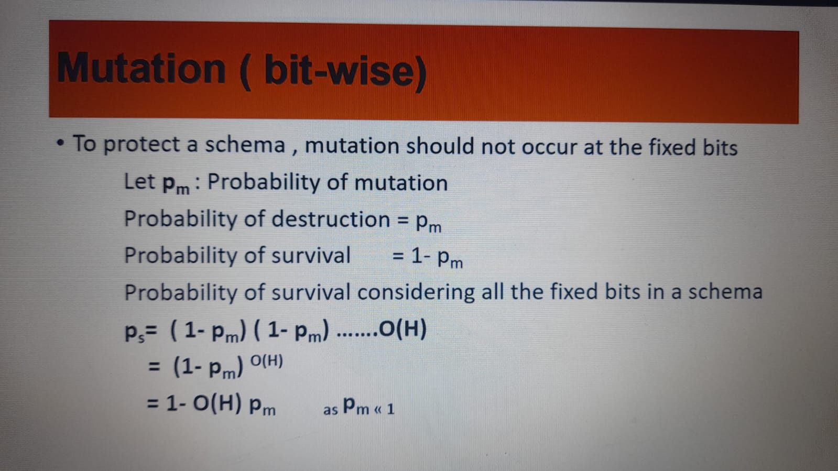
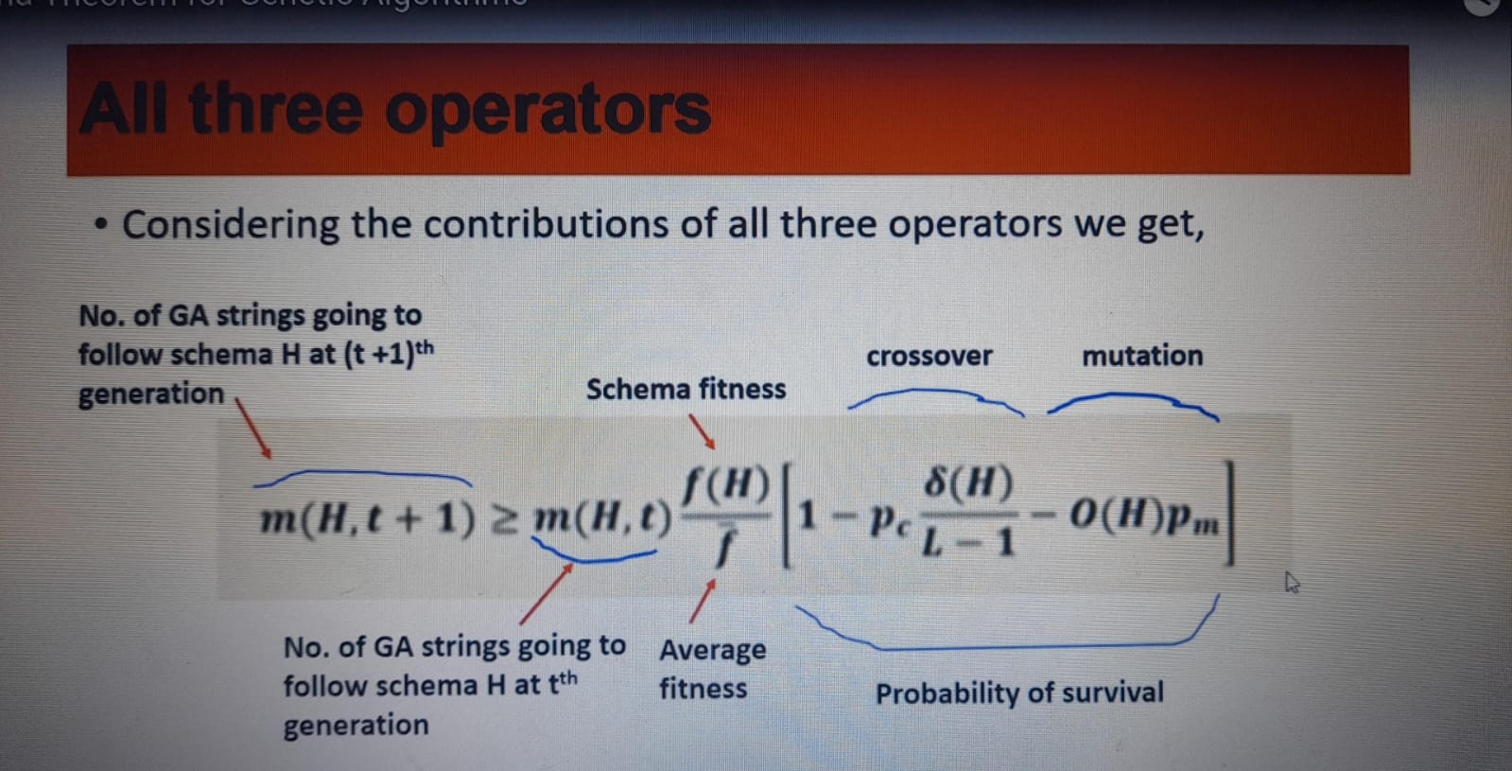
MUTATION(BIT-WISE)
ALL THREE OPERATORS

Slide 9
GENETIC PROGRAMMING
In genetic algorithms,when we use computer programs to represent hypothesis we call it as Genetic programming(GP)
To apply GP to a particular domain the user must define primitive functions(mathematical operations like addition, subtraction, multiplication, trigonometric functions (sin, cos), and others)and terminals(variables (like 'x' or 'y'), constants (like the number '2')

Slide 10
REPRESENTATION:
Programs manipulated by GP are represented by trees corresponding to parse tree of the program
Each function call(parent node)is represented by a node in the tree,arguments to the function call are given by its descendant nodes(child nodes)

Slide 11
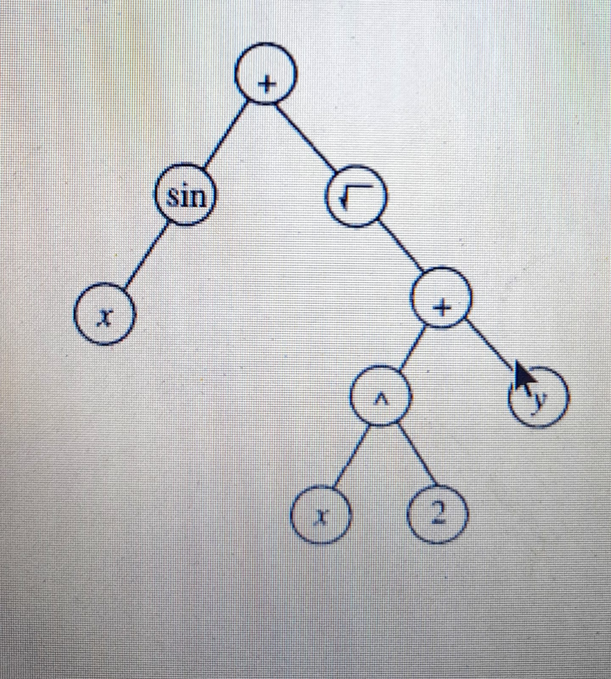
EXAMPLE:
Tree representation for the function sin(x)+√x^2+Y
Operands –terminals(other than operators all are operands)
Operators-primitive functions(in function we have +,√,^,+ )
In every iteration, a new generation of individuals is produced. The crossover operations are performed by replacing a randomly chosen subtree of one parent program by a subtree from another parent program.

Slide 12
CROSSOVER: Replace a normally chosen subtree of one parent program by a subtree from other parent program
EXAMPLE : P1: sin(x)+2(x+y)
P2:
Sinx+√x^2+y

Slide 13
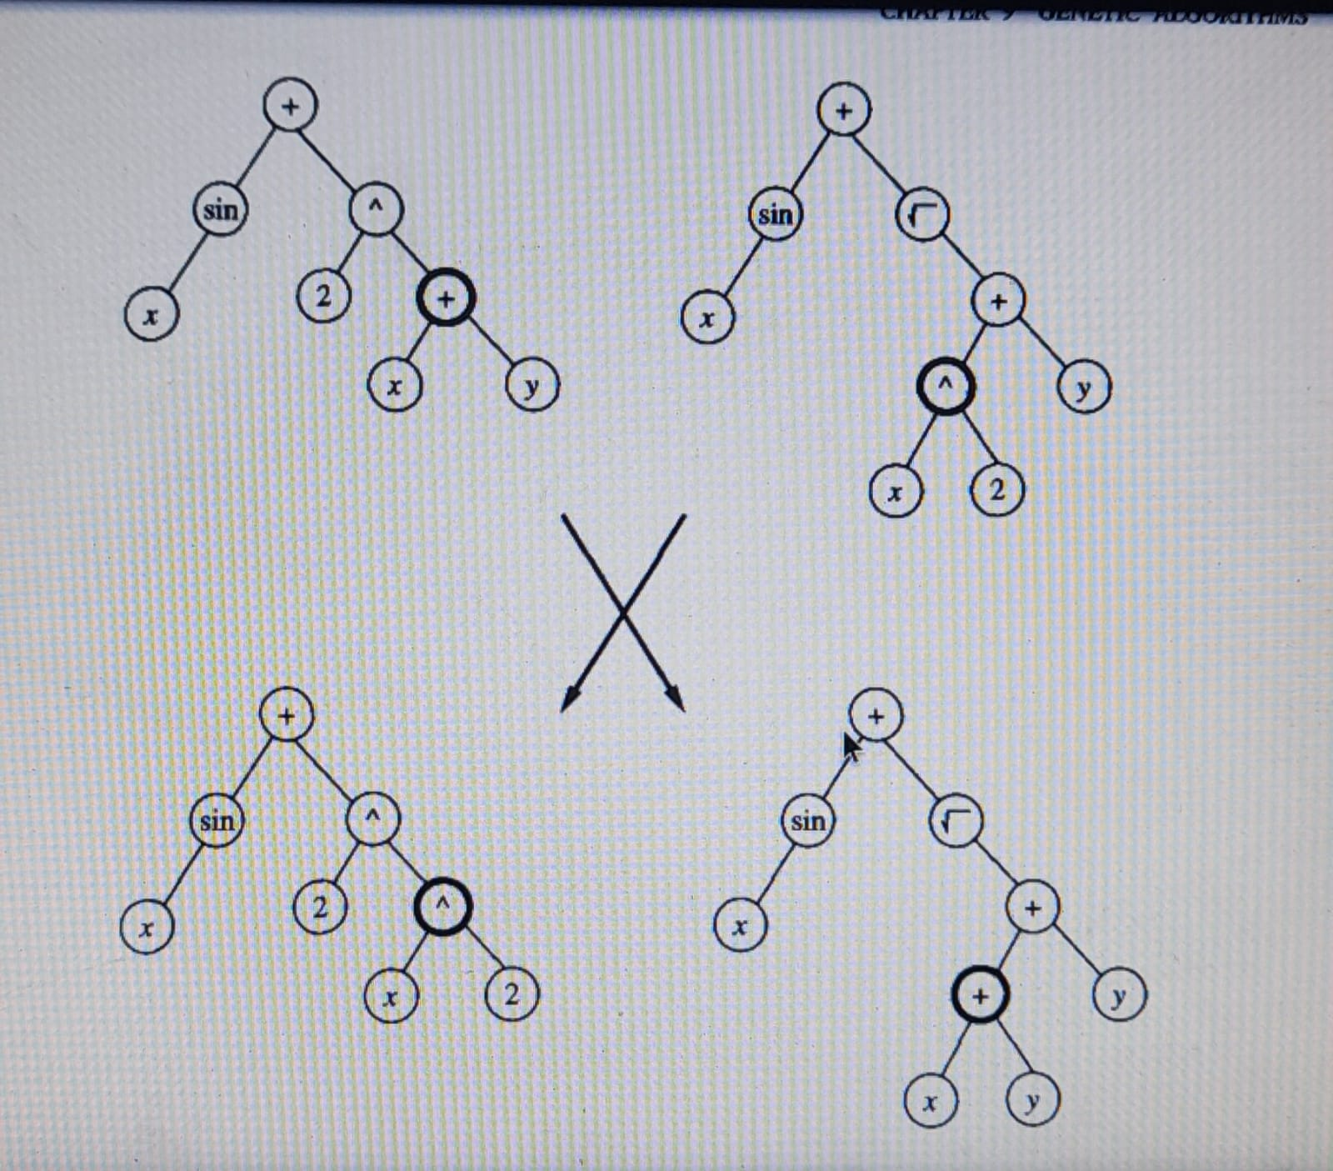
PS1:
Sin(x)+2^x^2
PS2:
Sin(x)+√(x+y)+y
The crossover points (nodes in bold) are chosen at random

Slide 14
THANK YOU

